Slide 1
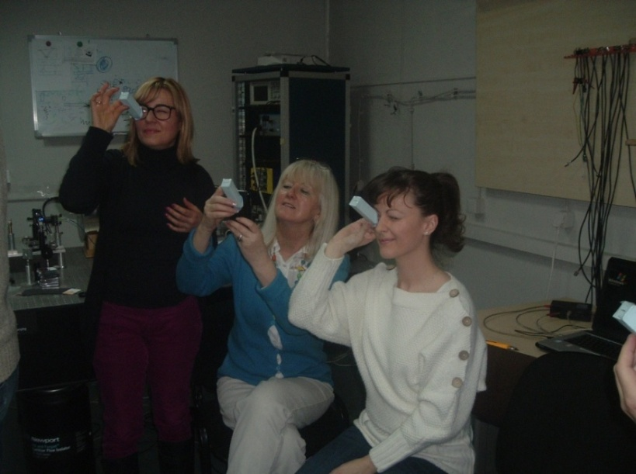
iSPEX- Spectropolarimeter for Planetary EXploration (SPEX)
PARTICIPATION OF BELGRADE/SERBIA
http://www.europe.light2015.org/Home.html, ispex-eu.org
Institute of Physics, March, 2015,
Observation of light spectrum through the hand made spectrometer add-on for mobile phone.
Beogradski iSPEX tim
ispex@ipb.ac.rs
Round table, The 5th International WeBIOPATR Workshop &Conference PARTICULATE MATTER, 14 October 2015, Belgrade

Slide 2
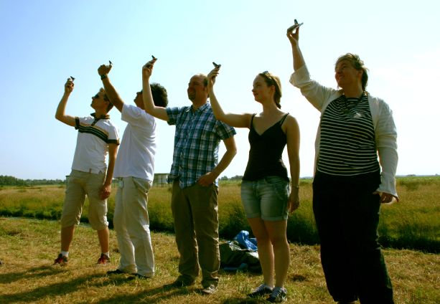
Citizens from Holland measure optical properties of light using ispex adds on.
ispex-eu.org

Slide 3
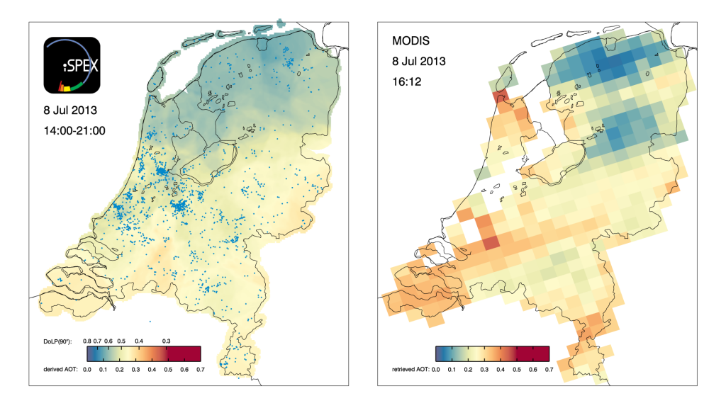
The iSPEX team, led by Frans Snik of Leiden University, analyzed all measurements from three days in 2013 and combined them into unique maps of dust particles above the Netherlands. The results match and sometimes even exceed those of ground-based measurement networks and satellite instruments.

Slide 4
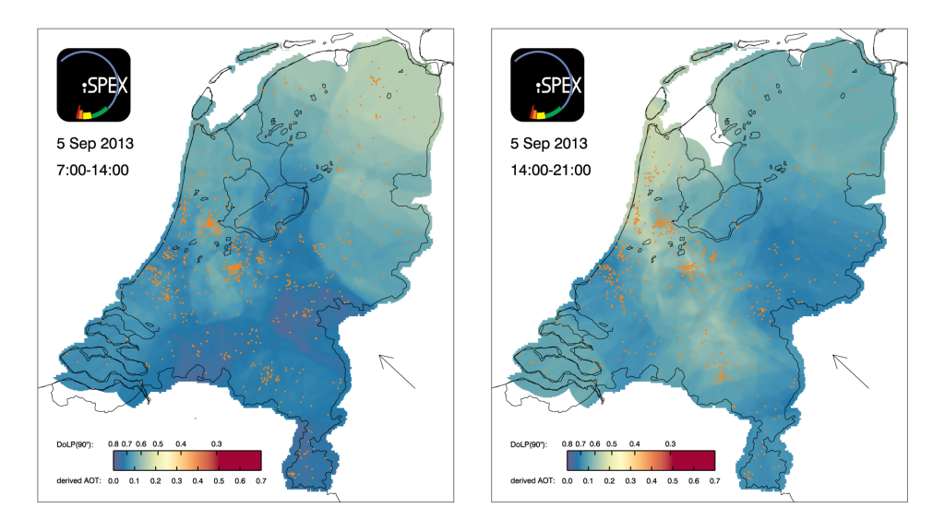
DoLP - Degree of linear polarization
AOT -Aerosol optical thickness
The iSPEX maps achieve a spatial resolution as small as 2 kilometers whereas satellite data are much courser. They also fill in blind spots of established ground-based atmospheric measurement networks. The scientific article that presents these first results of the iSPEX project was published in Geophysical Research Letters on 27 October 2014.

Slide 5
After a rigorous quality assessment of each submitted data point, measurements recorded in specific areas within a limited amount of time are averaged to obtain sufficient accuracy. Subsequently the data are converted to Aerosol Optical Thickness (AOT), which is a standardized quantity related to the total amount of atmospheric particles. The iSPEX AOT data match comparable data from satellites and the AERONET ground station at Cabauw, the Netherlands. In areas with sufficiently high measurement densities, the iSPEX maps can even discern smaller details than satellite data.

Slide 6

Join iSPEX-EU and Measure Air Pollution with your Smartphone
iSPEX - Ja učestvujem u planetarnom istraživanju pomoću spektropolarimetra na pametnom telefonu
belgrade@ispex-eu.org
ispex@ipb.ac.rs
LIGHT2015 is a high impact outreach and education project to promote the importance of photonics to young people, entrepreneurs and the general public in Europe during the International Year of Light and Light-based Technologies 2015.
You can play a vital part in helping scientists to better understand the impact that air pollution has on the environment and our health. With the iSPEX add-on and app, you can transform your smartphone into a scientific tool to measure tiny particles in the atmosphere that contribute to air pollution and its impacts in an as-yet poorly understood way.

Slide 7
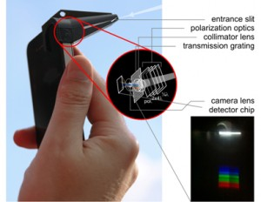
Spectropolarimeter for Planetary EXploration (SPEX)
iPHONE 4, 4S, 5, 5S

Slide 8
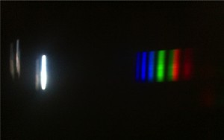
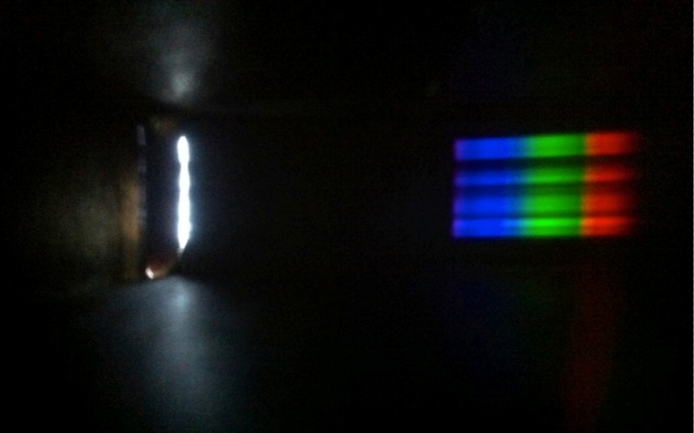
iSPEX modulated spectrum of partically polarized blue sky (top) and unpolarized clouds (bottom)
Modulisan spektar svetlosti ybog prisustva aerosola u vazduhu (gore) I spektar nepolarizovane svetlosti (bez prisustva aerosola) – (dole).

Slide 9
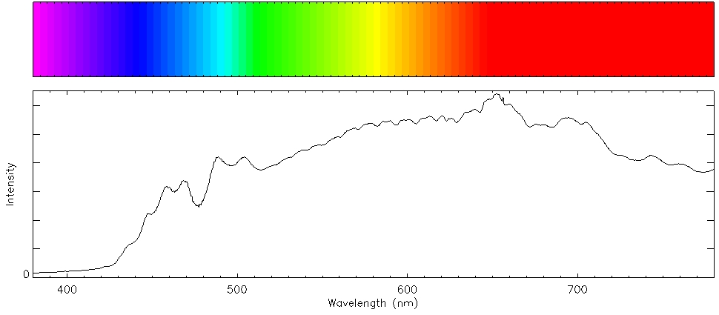
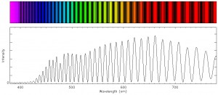
Spektar nepolarizovane svetlosti
Spektar
polarizovane svetlosti

Slide 10
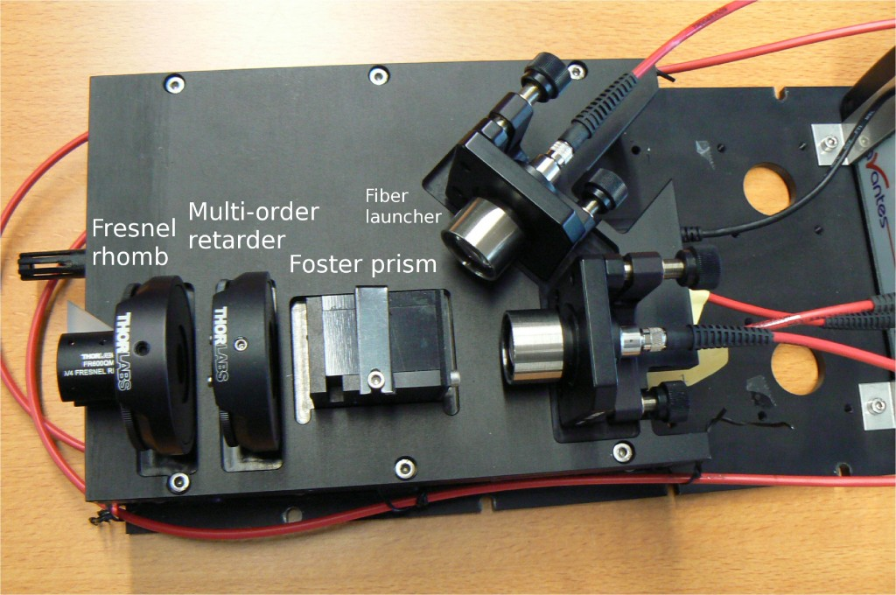
SPEX OPTICAL DESIGN
OPTIČKA ŠEMA UREĐAJA SPEX
Quarter wave plate, multi order wave plate, polarizer, spectrograph
Lamda/4 pločica, talasna pločica višeg reda, polarizator, spektrograf

Slide 11
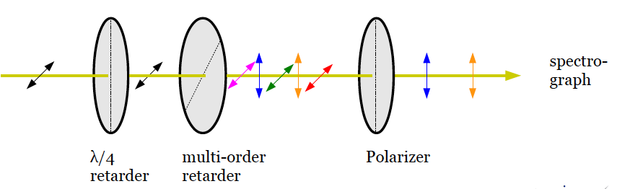
Conceptual drawing of the SPEX optical design. Of the incident horizontally polarized beam (indicated by the arrows), only certain colors keep this horizontal polarization, while the polarization angle of other colors is transformed by the multi order waveplate into vertical polarization. Only vertically polarized colors are transmitted by the polarizer.

Slide 12
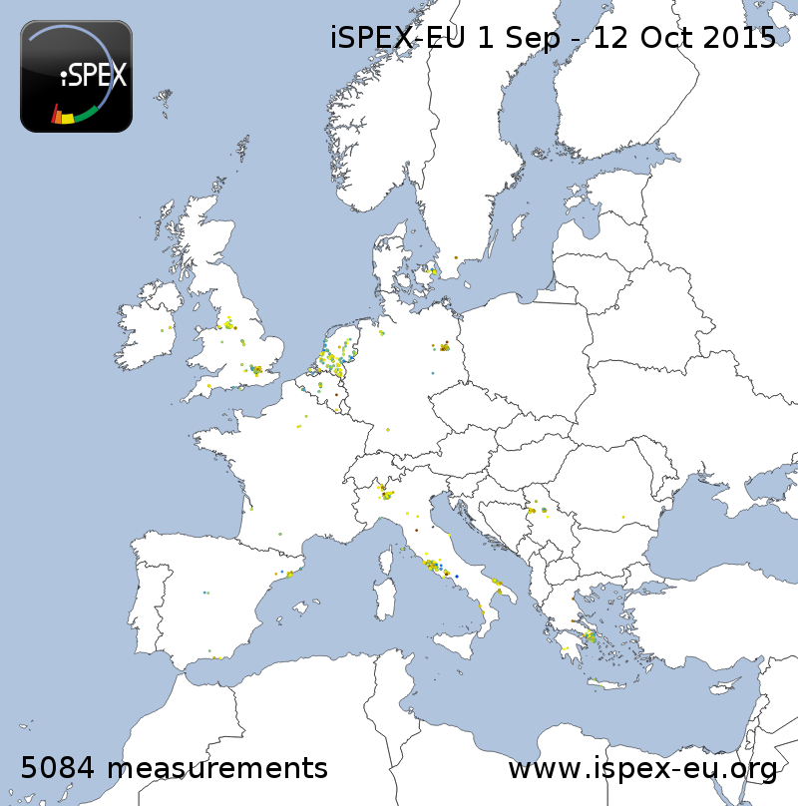

Slide 13
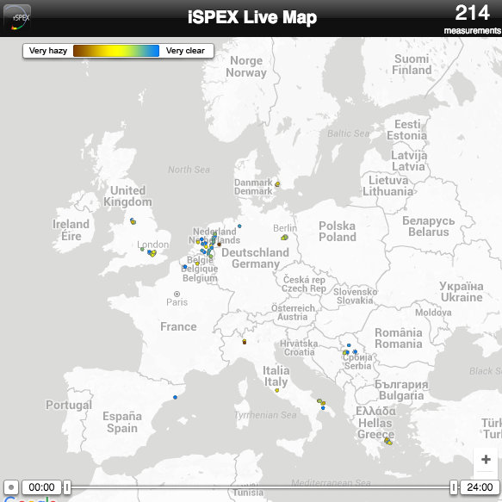

Slide 14
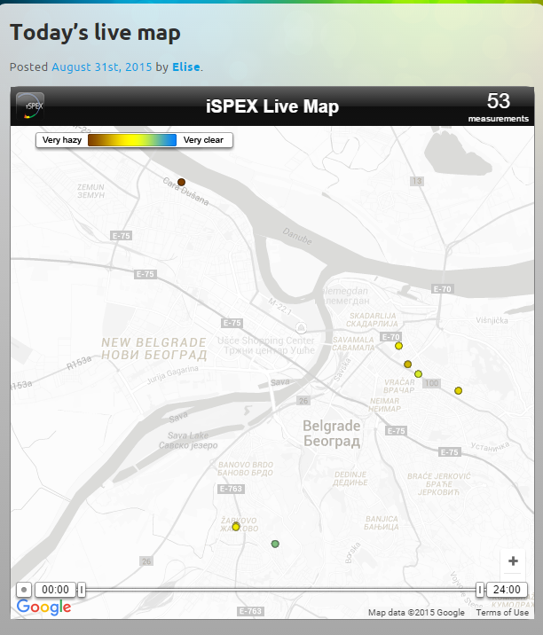
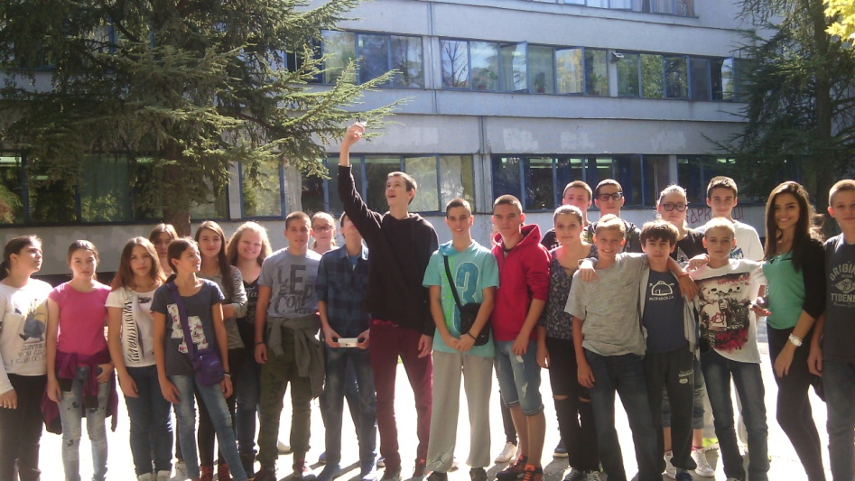
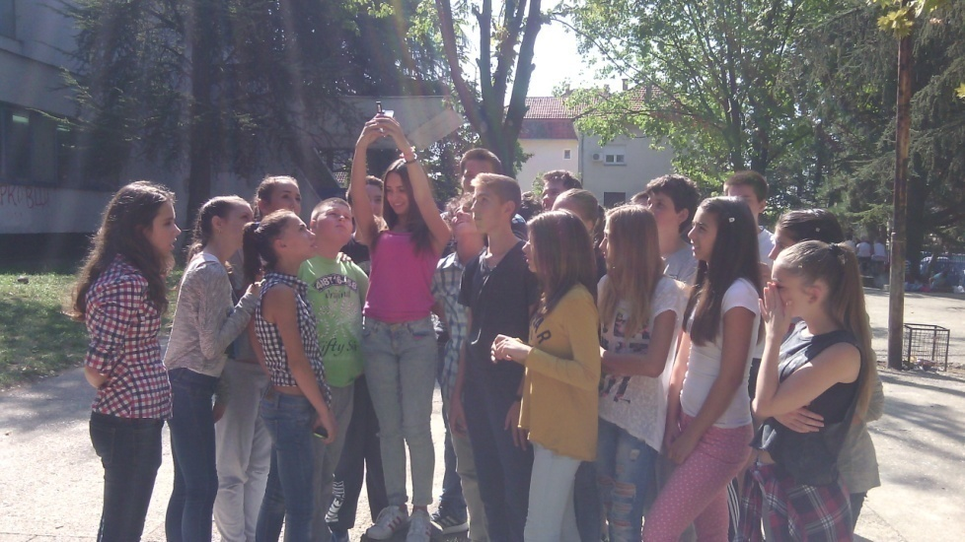
Students doing measurements in the Primary School Djordje Krstić, Belgrade
Measurements in Belgrade, 23 September 2015.

Slide 15
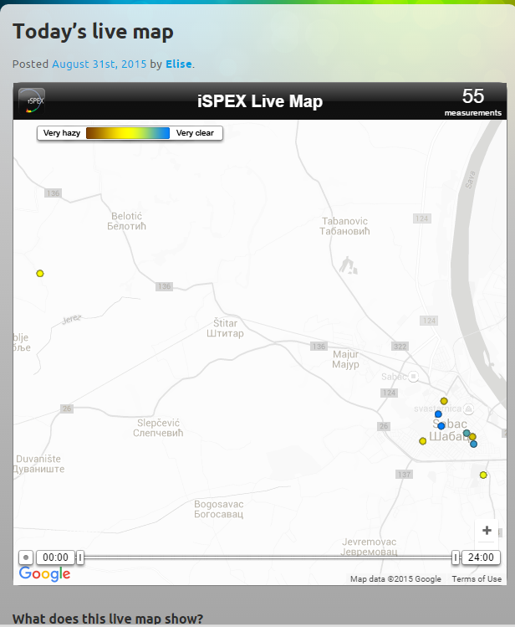
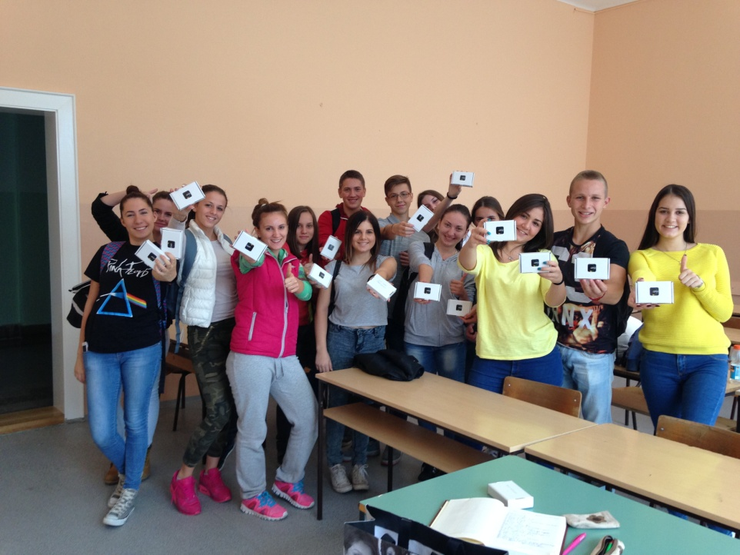
Students in the Medical school, Šabac after thez received ispex adds-on
Measurements in Šabac, 23 september 2015.

Slide 16



Belgrade iSPEX team
1. Mirjana Božić, Institute of Physics, Univerisity of Belgrade, team leader
2. Ilija Savić, Physics Faculty, University of Belgrade
3. Nenad Vukmirović, Institute of Physics, Univerisity of Belgrade
4. Darko Vasiljević, Institute of Physics, Univerisity of Belgrade
5. Zoran Mijić, Institute of Physics, Univerisity of Belgrade
6. Milena Davidović, Faculty of Civil Engineering, University of Belgrade
7. Jovica Milisavljević, Mathematical Grammar School
8. Biljana Stojičić, Zemun Grammar School
9. Goran Stojićević, Center for advanced training, Šabac
10. Milenija Joksimović, Chemical Nutritional Technological School, Belgrade
11. Ljiljana Ivančević, Primary School Djordje Krstić, Belgrade
12. Marijana Jović Lučić, Primary School Djordje Krstić, Belgrade
13. Tatjana Marković Topalović, Medical School dr Andra Jovanović, Šabac
14. Jovana Mišić, Primary School United Nations, Belgrade
15. Jelena Živanović, Zemun Grammar School
16. Sanja Bulat, Primary School Branislav Nušić, Belgrade
Project supported by:
The Center for promotion of science
Institute of Physics
Physical Society of Serbia
Physical Society of Serbia

